Slide 1


Expectations Meeting
Year 1

Slide 2

The Year 1 Team
1RH:
Miss Ross/Mrs Humphrey (Teachers)
Mrs Duffy
1R:
Mrs Rice(Teacher)
Mrs Nichols
PPA Cover
Miss Brook
Miss Townsend

Slide 3

Our Values
Believe, Achieve, Succeed
Throughout the school the TRAIN title will be displayed in classrooms and on displays and walls
T- Teamwork
R – Respect
A – Achievement
I – Initiative
N – Nurturing
We link our assemblies to or train values and as well as British values. This is also part of our character development.

Slide 4
The School Day
The school day starts at 8:45 am.
All children arrive and leave via cloakroom door.
Mornings – Maths, handwriting, phonics and English as well as provision based activities.
Afternoons – Reading and other curriculum subjects as well as provision based activities.
School finishes at 3:15pm.

Slide 5
School Day
Children will take part in a morning activity when they first come in. This will be based around maths.
The morning will include Maths, Handwriting, Phonics and English sessions as well as provision based activities..
Children will go to lunch at 11:45 until 12:30pm.
Afternoon sessions will include Reading and topic sessions as well as provision based activities..

Slide 6
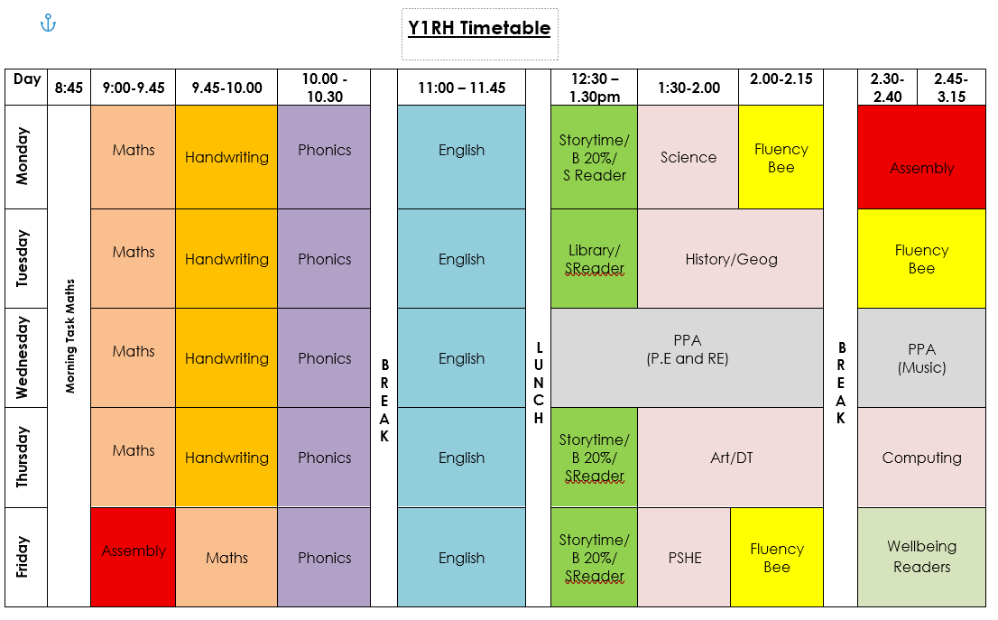
Example Timetable

Slide 7
Playtimes
Children will play in the KS1 playground
No toys are allowed in school
Children can bring a healthy snack or fruit. Crisps, chocolates are not allowed. We do have daily fruit for the children as well.
Children should have a water bottle with them every day.
Children should have a coat with them every day.

Slide 8
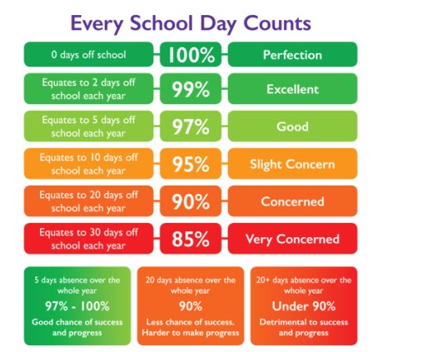
Attendance
School
Target
96%

Slide 9

Curriculum

Slide 10

Curriculum Newsletter
A newsletter will be sent home every half term and also put on the school website.
It will contain information about the topics the children will be learning about

Slide 11


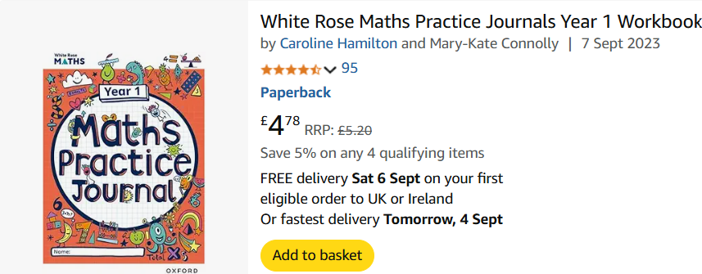
Curriculum Resources
Purple Mash - Purple Mash by 2Simple – Serial Mash for logging reading
White Rose 1 minute maths and White Rose Practice Journals.
Sfa phonics parent portal - Parent Portal parent code - q2stpu

Slide 12
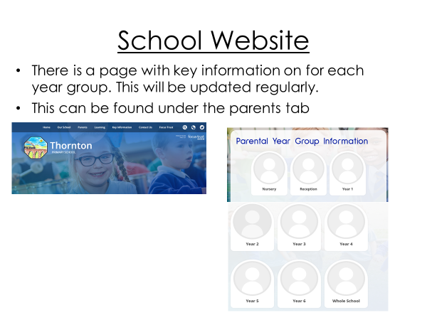

Slide 13
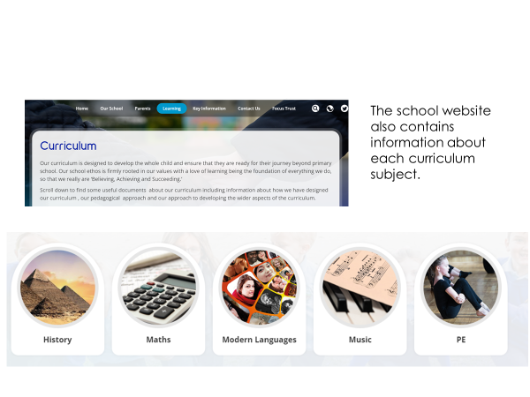
Curriculum Information

Slide 14
Behaviour Curriculum
The first two weeks will include a big focus on getting children to learn key school routines which are part of developing good learning behaviours and attitudes to learning.

Slide 15
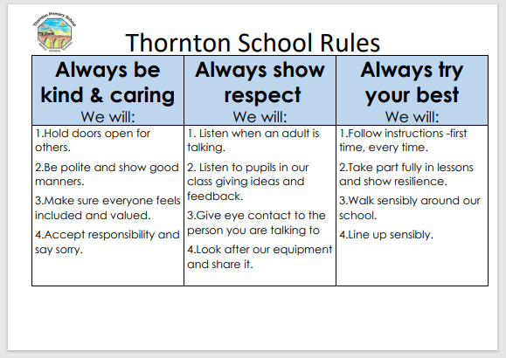
Thornton Always

Slide 16
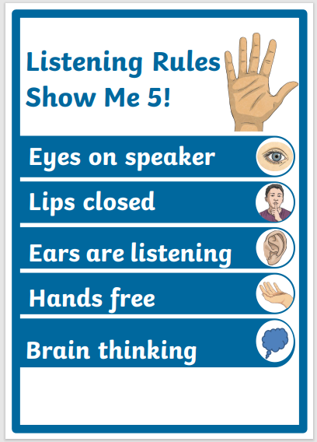
Active Listening Rules
Show me Five !

Slide 17
Behaviour Policy- Rewards
We have a positive behaviour policy
Children belong to a house and are rewarded with house points.
We will also send positive postcards home
Weekly assemblies celebrate different achievements linked to our values and phrase that pays for the week.

Slide 18
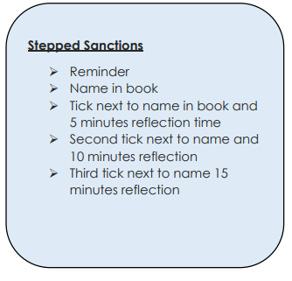
Behaviour Policy -Consequences
Severe behaviour will result in an automatic break or lunch time reflection

Slide 19
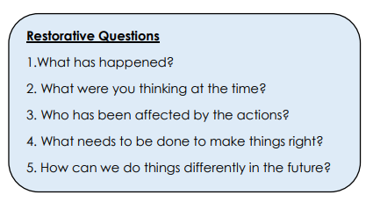
Restorative Approach

Slide 20


Weekly maths or English homework will be given out every Friday. A phonics newsletter will also be sent home to let you know the sound we have covered that week.
This is an opportunity for your child to consolidate their learning at home.

Slide 21


Reading
Please read with your child as often as possible.
It is important for children to build their fluency when they are reading. The more they can read at home the more confident and fluent they will become.
Decoding, Fluency and expression
Regular Learn by heart practise

Slide 22

Reading
Please log reading on our new online reading portal. More info on next slide.
Children will get a reading book matched to their phonics level.
They will also have access to online parent portal to read the FFT book the children will have practised in school during the week as part of shared reading.
Reading books will be sent home on a Friday and need to be returned by Wednesday to allow us to change them.

Slide 23
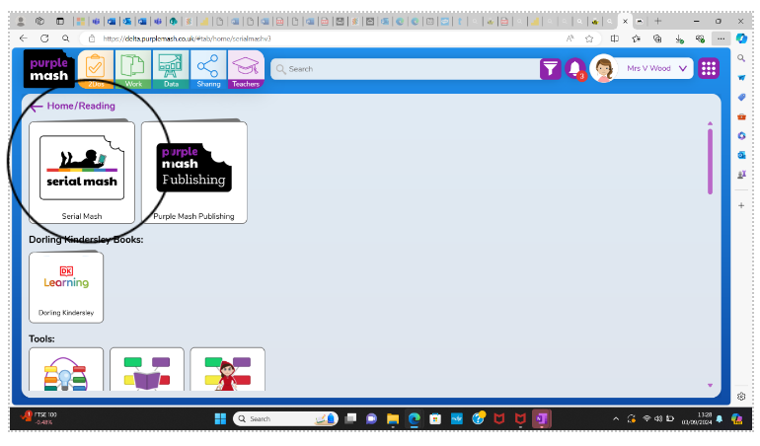
Serial Mash - How to use the Purple Mash Reading journal.
Parents are able to enter home reading records and view their child’s 1:1 reading. Serial Mash online books are recorded automatically on the child’s reading record.
1. Click on the Serial Mash icon.

Slide 24
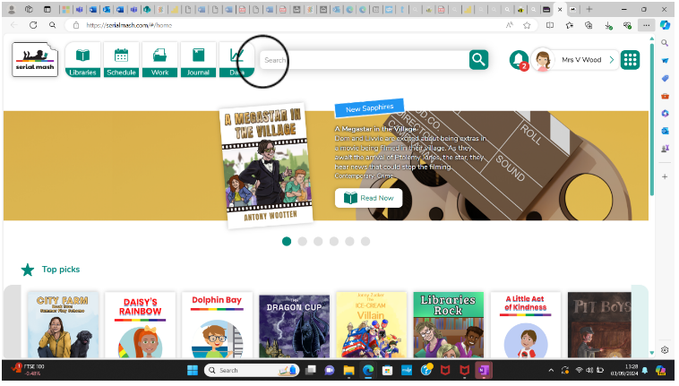
2. Click on the journal icon.

Slide 25
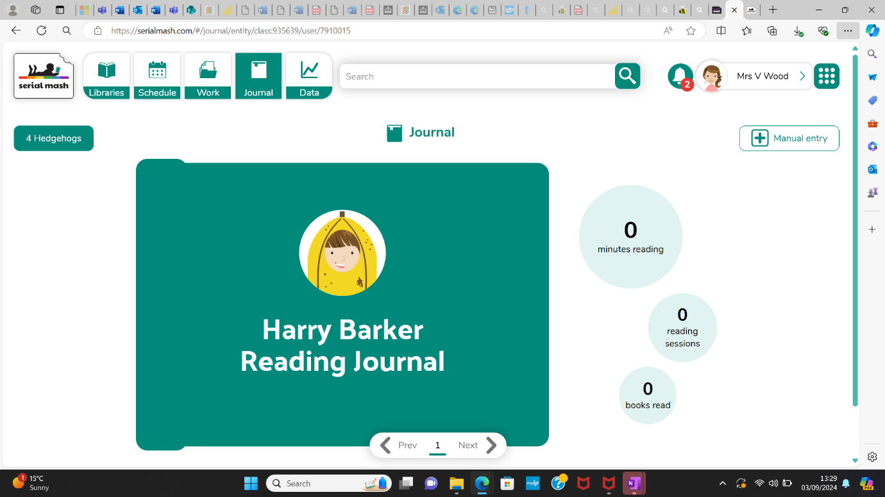
3. Select manual entry. Serial Mash online texts will be recorded automatically.

Slide 26
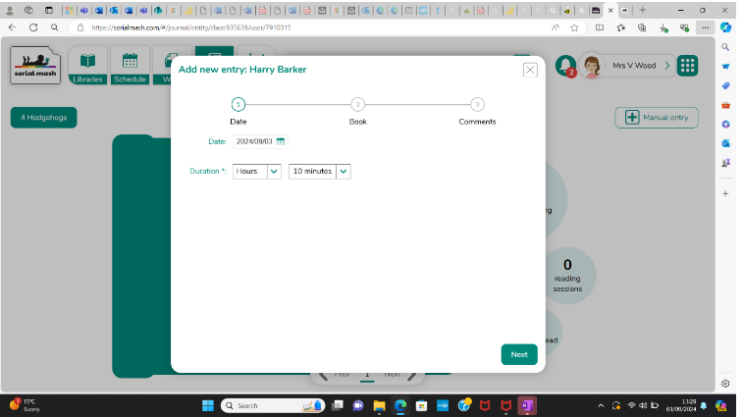
4. Select how long you have read with the child.

Slide 27
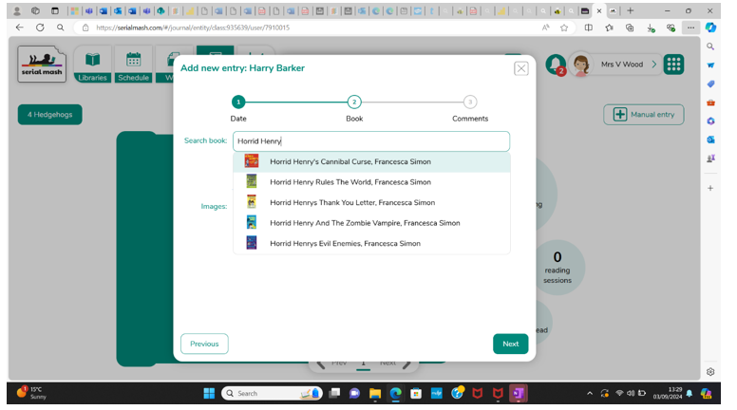
5. Enter title of book. If the book cannot be found, you can enter the title manually.

Slide 28

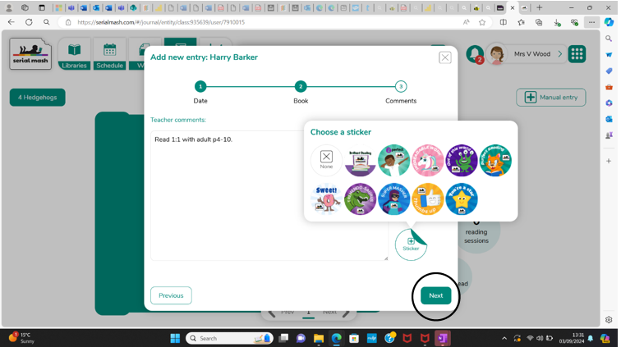
6. Enter a comment and press next. You can add a sticker too.

Slide 29
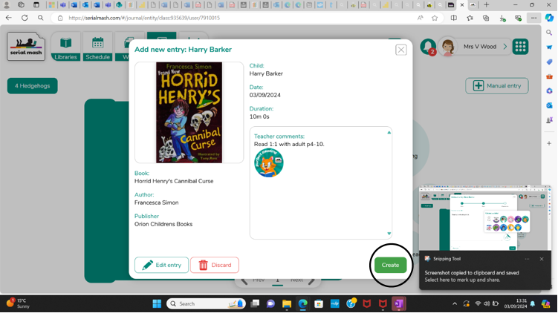
7. Check and edit, if necessary, then press create.

Slide 30
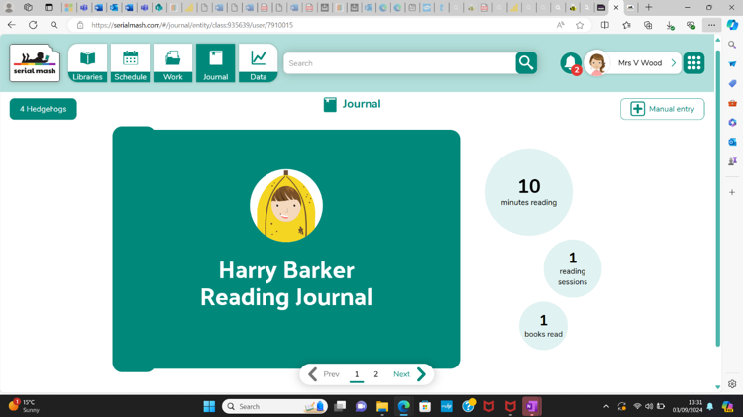
8. This will take you to the journal page and you can see how many books have been read etc.

Slide 31
Library
Children will have the opportunity to visit the library once a week and take a library book home. This needs to be returned weekly.
Children will need to return their library book before they can choose another
1RH library session will be on a Tuesday.
1R library session will be on a Thursday.

Slide 32

Uniform Including P.E.
Please ensure all uniform is clearly labelled.
School shoes – black shoes no trainers please on non PE days.
Trousers/skirt no leggings.

Slide 33
Uniform Including P.E.
PE is on a Wednesdays.
Please ensure your child comes in PE kit on these days and dressed appropriately for the weather.
Plain white T-shirt
Black/navy shorts
Plain black/navy jogging bottoms and sweatshirt (Y1-6)
Suitable trainers.

Slide 34

Any Questions?

